Slide 1
Assessment
Tisha Ewen-Smith, MSc
Rebekka J. Jez, EdD
Lyliana Rivera, EdD

Slide 2
Module Objectives
By the end of the module, you will be able to:
Learn about a learner from multiple people
Learn about a learner from multiple assessment sources
Use data collected about a learner to develop a learning plan with measurable goals
Create a progress monitoring plan to continue to collect data on a learner’s progress

Slide 3
Definitions
Academic assessment
Collaborative progress monitoring
Holistic Educational Assessment
Multidisciplinary teams
Social-Emotional-Behavioral assessment
Sociopolitical model of assessment
Zone of Proximal Development
Notes:
Academic assessment: refers to the assessment used to determine the levels and abilities regarding content knowledge such as reading, writing, language, and mathematics.
Holistic Educational Assessment: explores the child’s educational experience from multiple sources– interviews (learner, family/caregiver, educators, others), observations, formal and informal assessments, and review of school records– to allow the team to make a data-informed plan of support.
Multidisciplinary teams: a group usually composed of learner, family/caregiver, special education teacher, general education teachers, school administrators, and other support personnel (e.g., therapists, reading specialists, social workers).
Collaborative progress monitoring: when members of the multidisciplinary team work together to monitor the experiences (success and challenges) of a learner. Progress monitoring is most useful when there is a coordinated effort by multiple people on the team to observe, collect data, and share the information regularly.
Social-Emotional-Behavioral assessment: an examination of the social relationships, emotional regulation, and behavior responses a child displays. Social, emotional, and behavioral assessments are usually based on observations, checklists, and interviews that explore how the learner interacts with others, feels about their emotional well-being, communicates needs and desires, and acts within the school setting (e.g., executive functioning, attention).
Sociopolitical model of assessment: while the medical model of assessment aims at diagnosing a disability and connecting it with a remedy/cure and the social model of assessment examines the learner as part of a community with complex human cognition, emotions, and behaviors that may affect their educational experiences and focuses on how to support them in becoming happy, healthy members of society; the sociopolitical model perceives disability as a difference that derives from the expectations (or constructs) of society. A sociopolitical stance views a differing ability as something that can be addressed through a change in perspective, support, and resources decided upon with the youth, family/caregiver, educational professionals, and support personnel, as needed.
Zone of Proximal Development: Vygotsky’s (1978) Zone of Proximal Development (ZDP) describes that if learning is too hard or too easy, learners can become disengaged due to stress or boredom, but if the challenge is in the ZDP, learners tend to feel more excited about learning.

Slide 4
Importance of the Topic
Many youth with differing abilities have been excluded from school or are not getting their needs met
Sociopolitical model vs. medical model
Lack of training and resources
Deficit view

Slide 5
Steps for Assessment
Learn about the learner’s strengths, interests, preferences, and needs to support development of academic, social, emotional, and behavioral skills
Administer assessments and collect data (formal, informal, observational)
Analyze data and write a report that is accessible to learners, families, educators, and support providers
Create a plan with measurable goals that involves the learner and family/caregiver in planning which will be shared with learner, family and other educators
Collaborative progress monitoring with regular check-ins

Slide 6
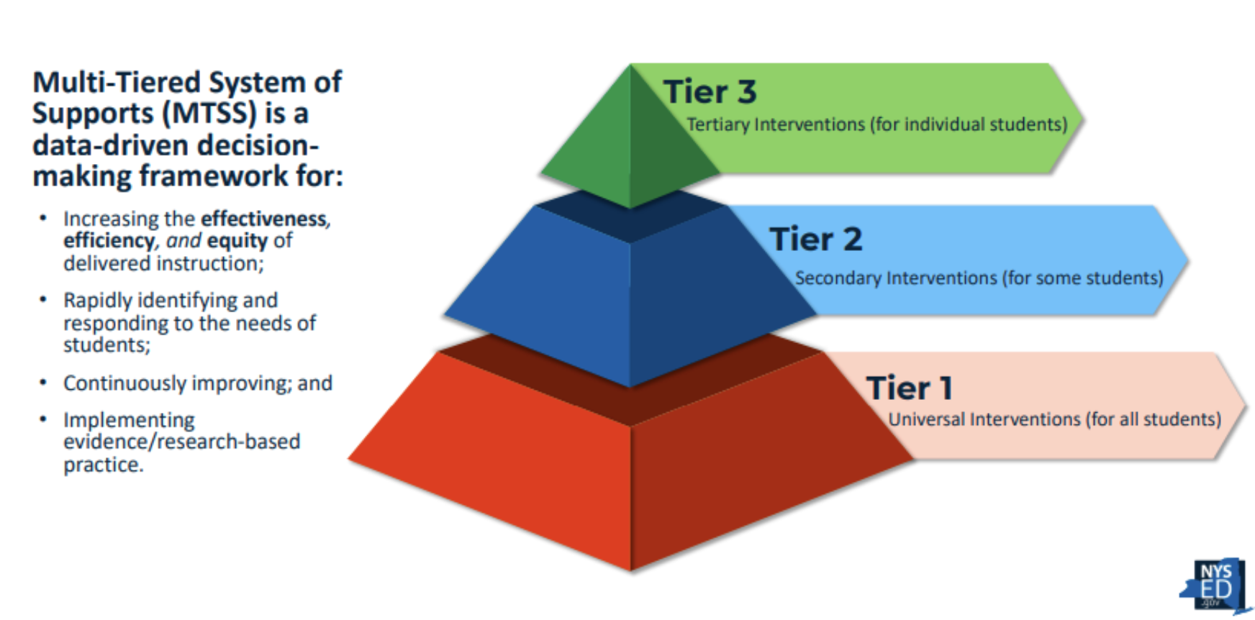
MTSS: Areas of Assessment
Tier 1: Universal Assessment (screening)
Tiers 2 & 3: Learning More About Learners Assessment (diagnostic, progress monitoring, outcome)
Academic: areas and skills
Social: relationships
Emotional: self-awareness, trauma-informed
Behavior: executive functioning
Speech & language: communication

Slide 7
Contextualizing Assessment
Before completing the activity, you may need to think about:
Regional legislation
Access to materials
Time
Resources
Access to personnel, family
School level restrictions, flexibility, and roles/duties
Language and/or cultural differences

Slide 8
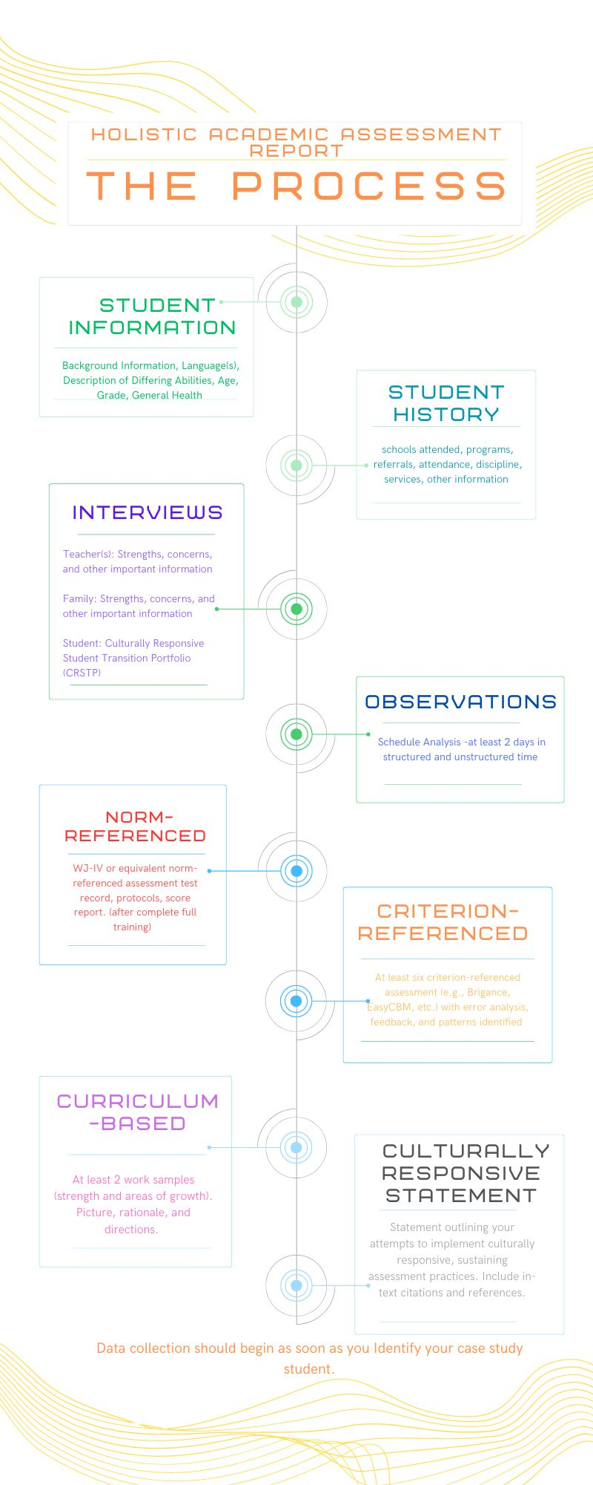
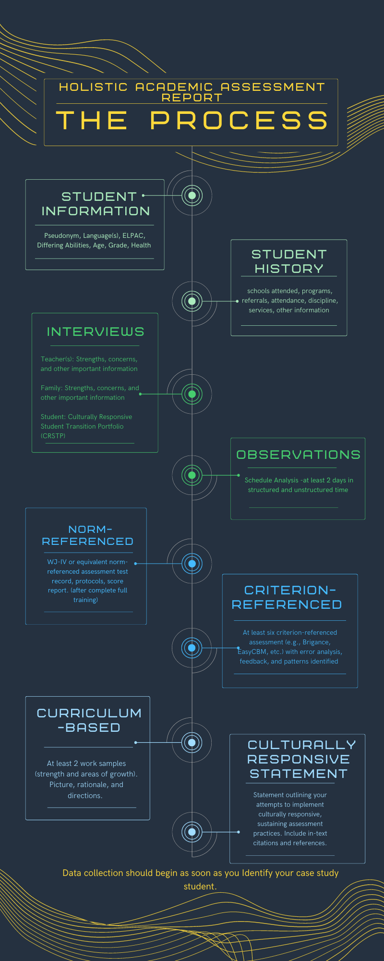
Assessment Resources
Assessment Tools Folder (Resources for International and North America)
IRIS Modules on Assessment:
Assessing the General Education Curriculum
Accommodations during testing
Collecting and analyzing data for data-based individualization
CEEDAR/CEC High Leverage Practices: Assessment

Slide 9
Selected References
Aceves, T. C. and Kennedy, M. J. (Eds.) (2024, February). High-leverage practices for students with disabilities. 2nd edition. Arlington, VA: Council for Exceptional Children and CEEDAR Center.
Annamma, S. A., Connor, D. J., & Ferri, B. A. (2013). Dis/ability Critical Race Studies (Discrit): Theorizing at the Intersections of Race and Dis/ability. Race Ethnicity and Education 16 (1): 1–31. doi:10.1080/13613324.2012.730511.
Artiles, A. J., Kozleski, E., Trent, S., Osher, D., & Ortiz, A. (2010). Justifying and explaining disproportionality, 1968-2008: A critique of underlying views of culture. Exceptional Children, 76, 279-299.
Basha, T. Y. A., Al-Sana'ani, A. S., & Al-Mekhlafi, S. A. S. (2024). Inclusive Education in Yemen: Policies, Practices, and Barriers. Journal of International Special Needs Education.
Brownell, M. T., Jones, N. D., Sohn, H., & Stark, K. (2020). Improving teaching quality for students with disabilities: Establishing a warrant for teacher education practice. Teacher Education and Special Education, 43(1), 28-44.
Evans, C. M. (2023). Applying a Culturally Responsive Pedagogical Framework to Design and Evaluate Classroom Performance-Based Assessments in Hawai’i. Applied Measurement in Education, 36(3), 269–285. https://doi.org/10.1080/08957347.2023.2214655
Jez, R. J. (2023), Special Education Services and CRT: Dismantling the Singular Identity and Honoring Intersectionality. Lalas, J.W. and Strikwerda, H.L. (Ed.) Contextualizing Critical Race Theory on Inclusive Education From a Scholar-Practitioner Perspective (International Perspectives on Inclusive Education, Vol. 22), Emerald Publishing Limited, Leeds, pp. 113-139. https://doi.org/10.1108/S1479-363620230000022007
Jez, R. J, Hauth, C., & Ramers, L. (2022). Transforming educators in the United States and South Africa: An international collaboration to enhance culturally responsive inclusive practices. Journal of International Special Needs Education 24(2), 1-12. doi: https://doi.org/10.9782/JISNE-D-20-00009 ISSN: 2159-4341 eISSN: 2331-4001
Kozleski, E. B., Artiles, A. J., & Skrtic, T. M. (2014). What are high quality instruction and support in high need and culturally diverse schools? In Handbook of Effective Inclusive Schools (pp. 128-145). Routledge.
Lawson, A., & Beckett, A. E. (2021). The social and human rights models of disability: towards a complementarity thesis. The International Journal of Human Rights, 25(2), 348-379.
Lubin, J. (2020). Roles of special educators in St. Lucia: Implications of policy and practice on inclusion. Journal of International Special Needs Education, 23(1), 33-44.
O’Dwyer, E. P., Sparks, J. R., & Nabors Oláh, L. (2023). Enacting a Process for Developing Culturally Relevant Classroom Assessments. Applied Measurement in Education, 36(3), 286–303. https://doi.org/10.1080/08957347.2023.2214652
United Nations (2018). Report on disability and development: realization of the Sustainable Development Goals by, for and with persons with disabilities. UN Doc. A/73/220 https://www.un.org/development/desa/disabilities/publication-disability-sdgs.html
Ydesen, C., Milner, A. L., Aderet-German, T., Caride, E. G., & Ruan, Y. (2023). Educational Assessment and Inclusive Education: Paradoxes, Perspectives and Potentialities. Springer Nature.

